Slide 1
How is Leaf being used in the last year?
Presented by: José Carriço
Last Updated: December 4 th, 2024

Slide 2
Table of Contents
01
2
4
5
3
Objective: “Study Goals”
Analysis: “Key Insights from the Data”
Data Source and Scope: “Where Data Came From”
Conclusions: “Main Takeways”
Recommendations: “Provide actionable steps based on findings”

Slide 3
Objective
Understand key usage patterns of Leaf over the last year;
Identify trends, user behaviors and opportunities for improvement.

Slide 4
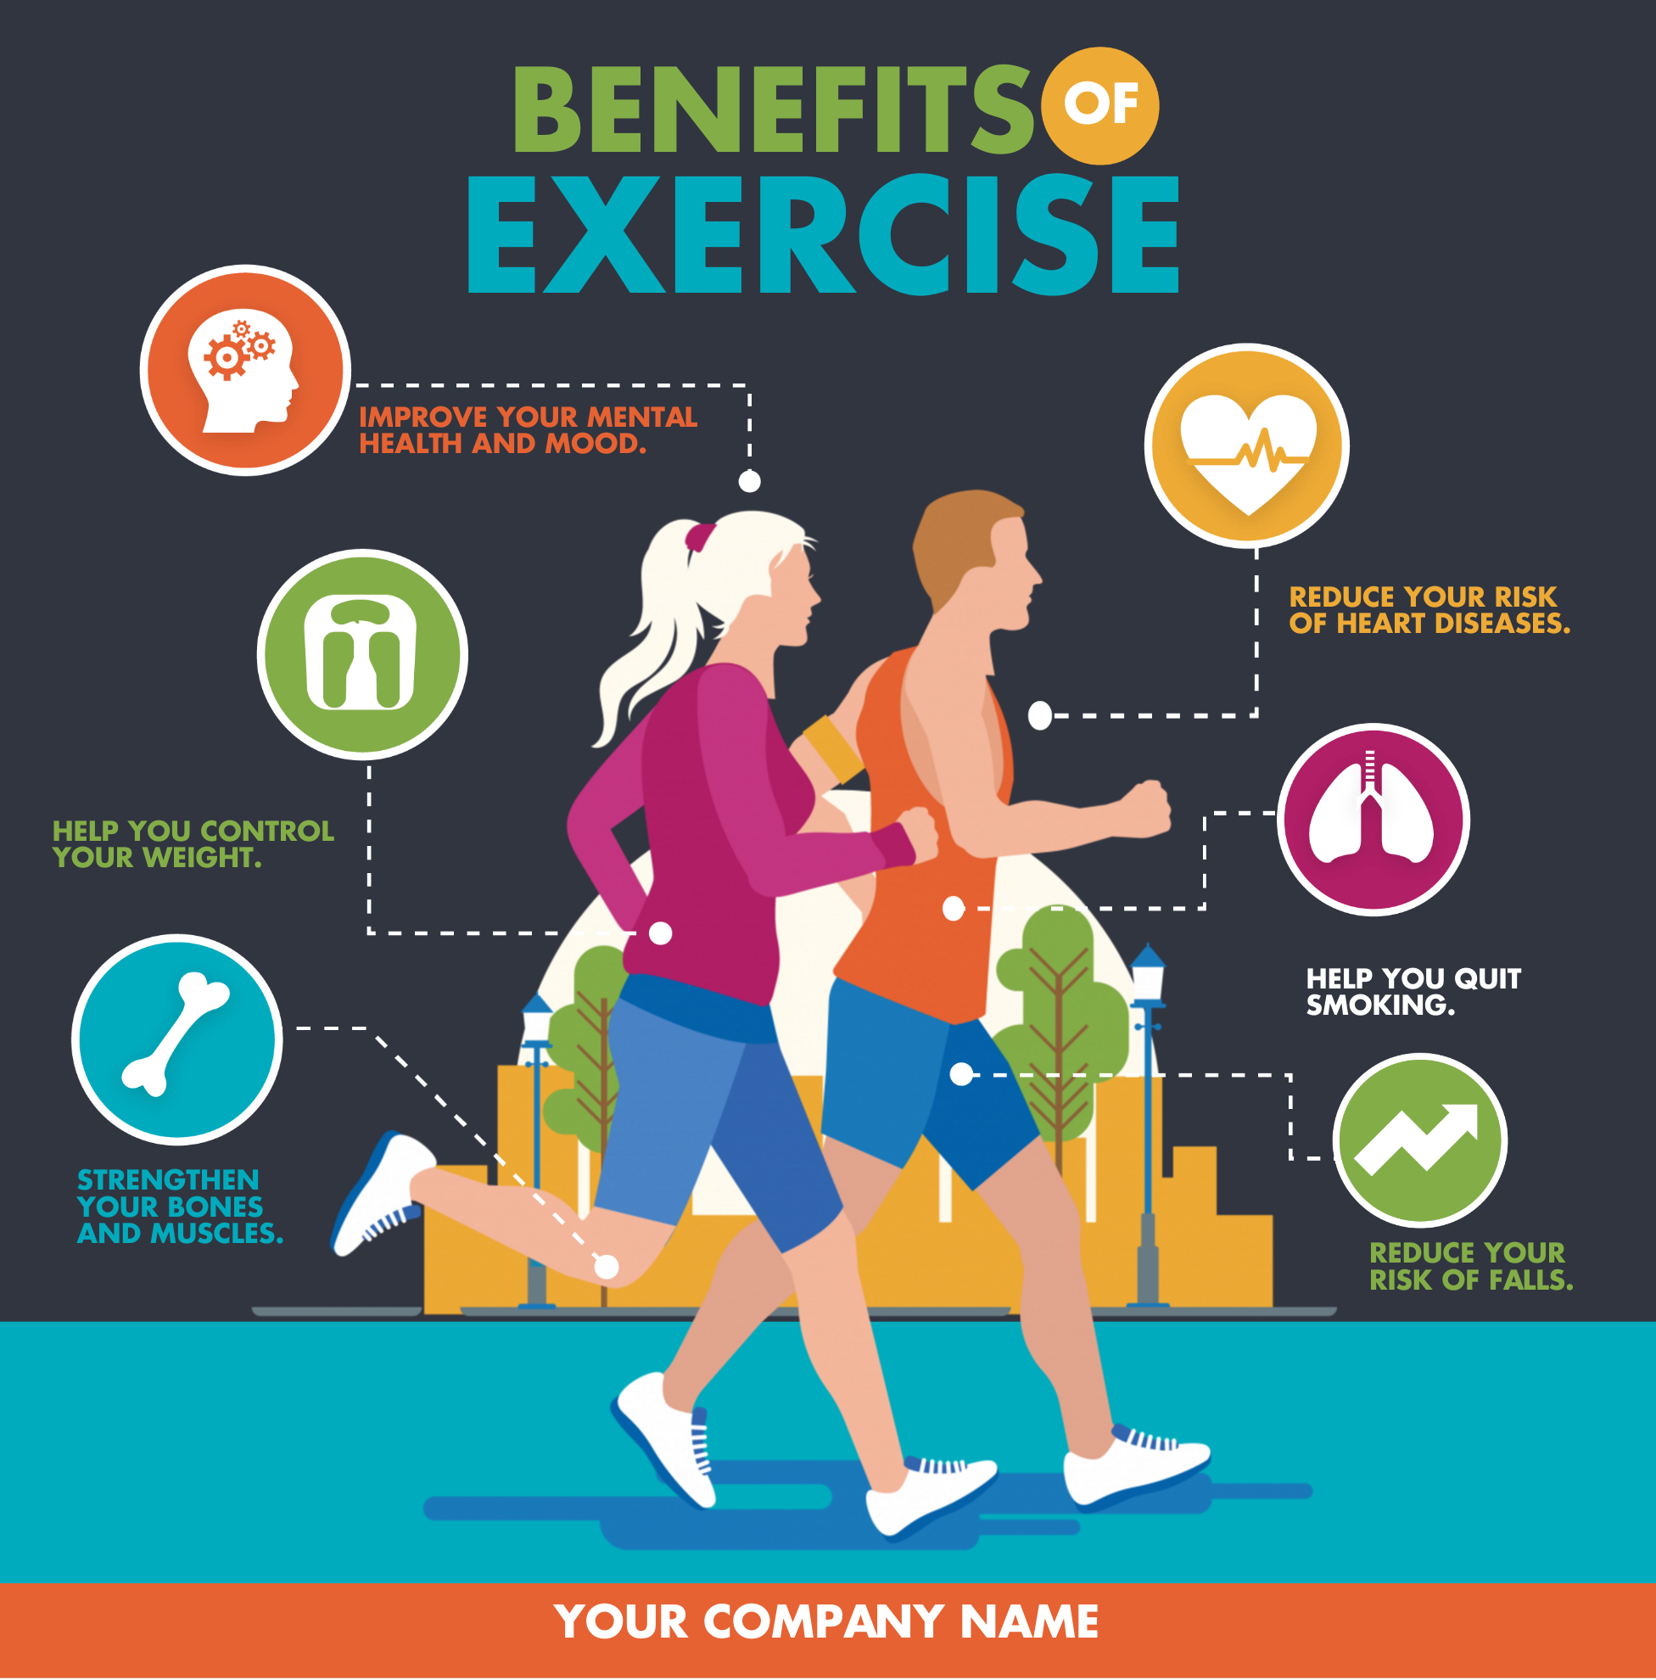

Data Sources and Scope
Data Sources
Scope
Survey Respondents: Data collected via Amazon Mechanical Turk (Mturk) from 30 eligible Fitbit users.
Personal Tracker Data:
Physical Activity;
Heart Rate;
Sleep Monitoring.
Survey TimeLine: 3/12/2026 – 5/12/2026
Participants Details: Fitbit Users with varied tracker types and usage preferences;

Slide 5
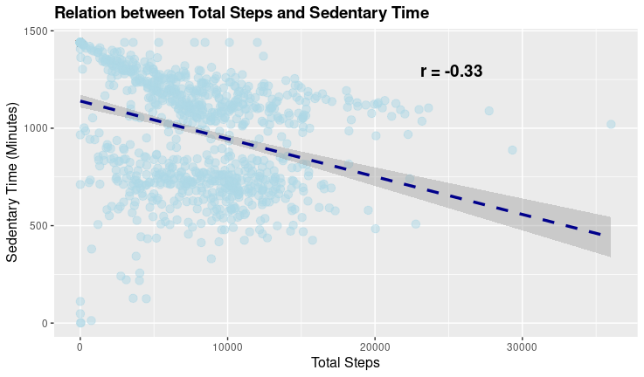
Analysis
The Steps x Time Sedentary
As the total number of steps increases, the time spent being sedentary tends to decrease.
There is a variability in sedentary time for those with low step counts.
But higher step counts show less variation, as they consistently exhibit lower sedentary minutes

Slide 6
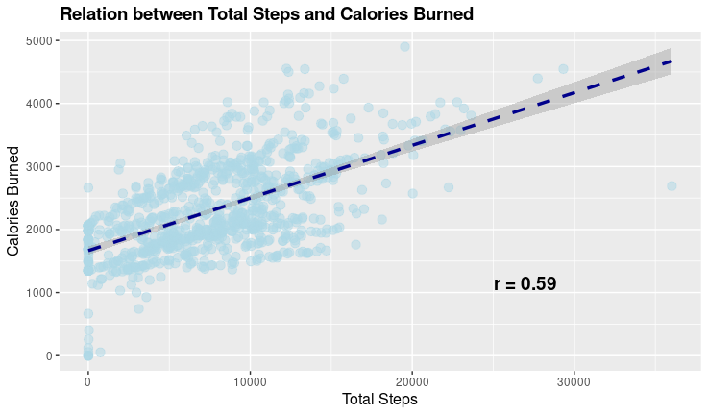
Analysis
The Steps x Calories
We can see that as the total number of steps increases, the calories burned tends to increases.
The range extends f rom 0 to approximately 30,000 steps, showing diversity in participant activity levels

Slide 7
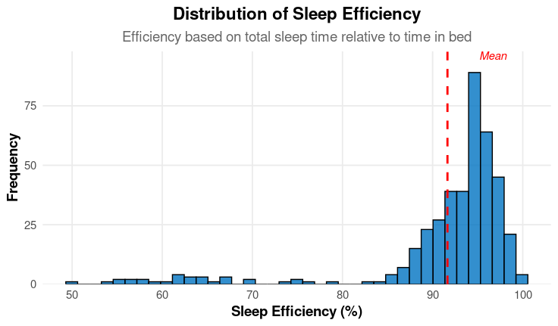
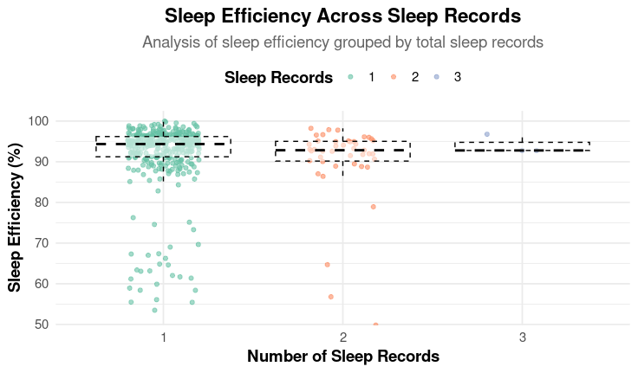
Analysis
The Distribution os Sleep Efficiency
Most participants are getting good quality sleep, as indicated by the high concentration near 90-100% range.
Sleep Efficiency Across Sleep Records
As the number of sleep records increases, the variability in sleep efficiency tends to decrease, especcialy in individuals with more consistente sleep monitoring

Slide 8
Conclusions
1
2
3
Sedentary behavior is growing concern, but tracking and increasing daily steps is na effective way to combat it and promote a healthier lifestyle.
A powerfull way to burn calories is trough walking and our findings show that increasing daily walking significantly boosts calories burn.
Most user maintain high sleep efficiency, wich improves with the number of sleep records, suggesting that consistente tacking helps establish better sleep patterns.

Slide 9

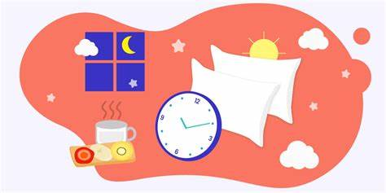
Recommendations
Tracking Steps
Controlling the Sleep
Highlight the importance of step tracking for overall health. Notifications reminding users of daily step goals, progress, and achievements can motivate them to stay active and adopt healthier habits.
Use app notifications to guide users toward better sleep hygiene, such as reminders for bedtime and tips to improve sleep quality. Encouraging users to monitor their sleep data can foster better long-term habits and improve overall well-being.

